Slide 1
Hotel Revenue Management Model

Slide 2
Business Understanding
Business Problem
Data Mining Solution
Business Value
Cancellations lead to revenue loss, poor utilization, and operational efficiency problems
In the dataset, 37%were canceled before the arrival date accounting for 16 M euros of lost revenue
Predict whether a customer will cancel the hotel booking or not
Increase efficiency and profit by overbooking

Slide 3
Data Understanding
The dataset contains hotel bookings from various countries between 2015 – 2017
Features/Attributes
Demographics: country, customer type, adults, children, babies,…
Booking Information: lead time, arrival date week number, previous cancellations, previous bookings not canceled, booking changes, ADR(Average Daily Rate),…
Services: meal, market segment, distribution channel, …
Hotel type: hotel
Target
is_canceled (0/1)

Slide 4
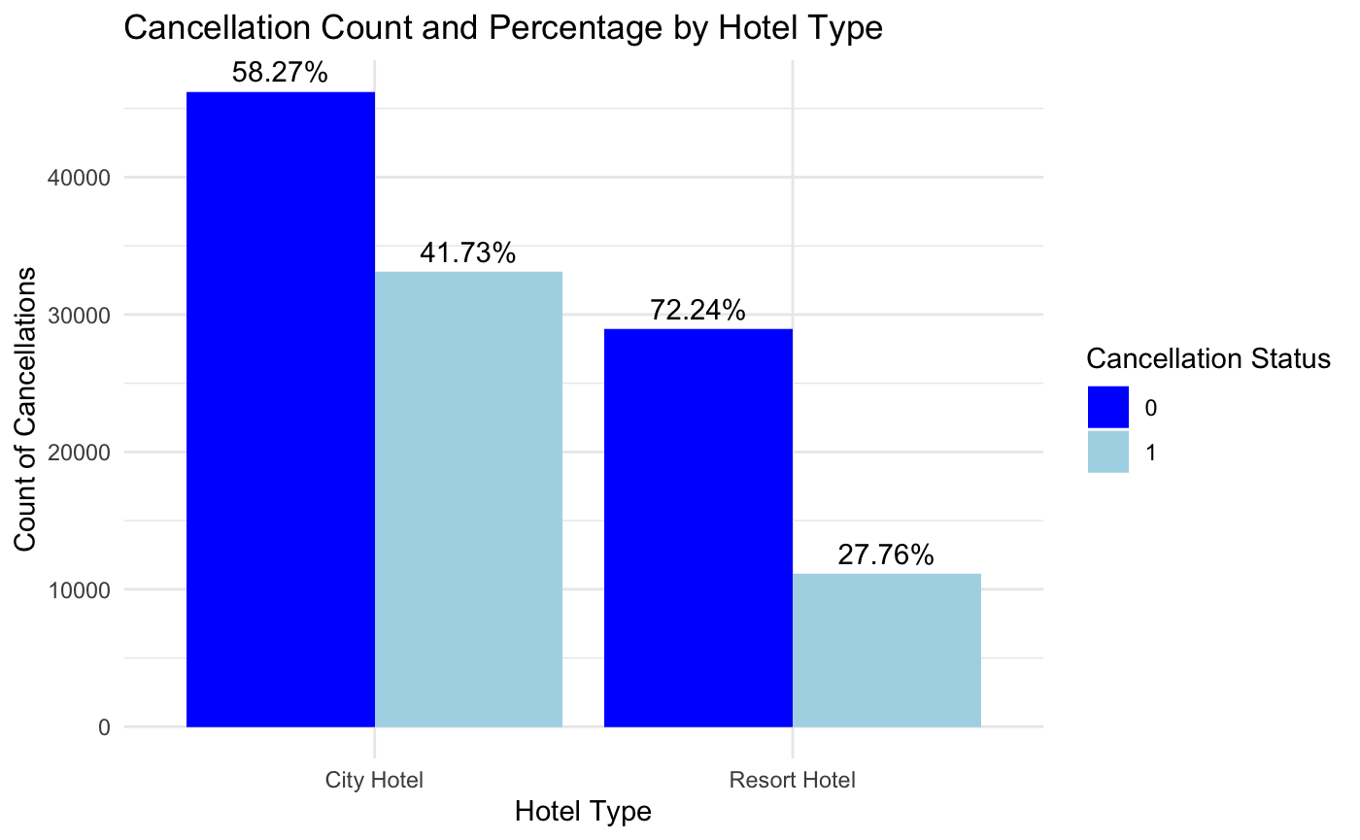
Data Visualization
Booking count and cancellation percentage by Hotel Type
More bookings in a city hotel when compared to the resort, cancellation percentage is also higher.
Resort hotels: customers usually planned in advanced for traveling purpose and has lower possibilities to cancel
Count of Hotel Bookings

Slide 5
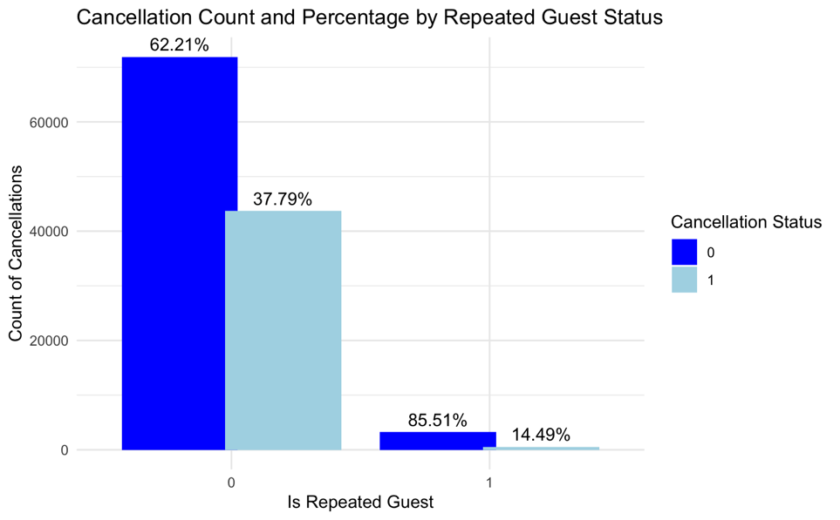
Data Visualization
Repeated guests are less likely to cancel the bookings. This might be because the customers are loyal, or they might be frequent visitors for work purposes

Slide 6
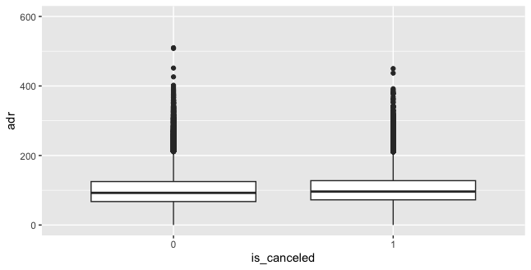
Data Visualization
Hotel’s average daily rate didn’t significantly affect the cancellation action.

Slide 7
Modeling
Binary prediction: Utilize supervised learning models for classification purpose
Cross-validation: K-fold cross-validation
The performance metrics: OOS Accuracy
Prediction Result: 84.378%
Model | OOS Accuracy
Logistic Regression | 81.43%
SVM | 82.84%
Classification Tree | 80.30%
XGBoost | 84.09%

Slide 8
K-means Clustering
 | is_ canceled | lead_time | arrival_date_day _of_month | adults | children | babies | is_repeated_ guest | adr
1 | 0.348 | 43.285 | 16.159 | 2.020 | 0.278 | 0.012 | 0.011 | 166.994
2 | 0.249 | 31.320 | 15.562 | 1.718 | 0.043 | 0.007 | 0.0642 | 75.273
3 | 0.451 | 160.728 | 16.040 | 1.911 | 0.096 | 0.007 | 0.004 | 103.189
4 | 0.644 | 326.526 | 15.488 | 1.945 | 0.047 | 0.003 | 0.015 | 85.041

Slide 9
Deployment
The results from the data mining should be used to predict whether the customer cancel the booking or not
By calculating the percentage of booking rate minus the cancellation, the hotels would be able to release certain percentage of rooms for overbooking
Mitigate the risk of overbooking problems by setting conservative overbooking thresholds and partnering with other local hotels
9

